Slide 1
Gradient and ITS Type

Slide 2
What is Gradient Descent?
Gradient Descent is a popular optimization technique in Machine Learning and Deep Learning, and it can be used with most, if not all, of the learning algorithms. A gradient is the slope of a function.
It measures the degree of change of a variable in response to the changes of another variable. Mathematically, Gradient Descent is a convex function whose output is the partial derivative of a set of parameters of its inputs.
The greater the gradient, the steeper the slope.
Starting from an initial value, Gradient Descent is run iteratively to find the optimal values of the parameters to find the minimum possible value of the given cost function.

Slide 3
Types of Gradient Descent:
Typically, there are three types of Gradient Descent:
Batch Gradient Descent
Stochastic Gradient Descent
Mini-batch Gradient Descent

Slide 4
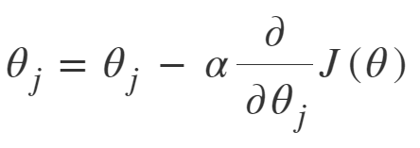
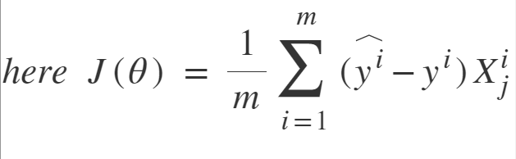
Batch Gradient Descent:
Batch Gradient Descent involves calculations over the full training set at each step as a result of which it is very slow on very large training data. Thus, it becomes very computationally expensive to do Batch GD. However, this is great for convex or relatively smooth error manifolds. Also, Batch GD scales well with the number of features.

Slide 5
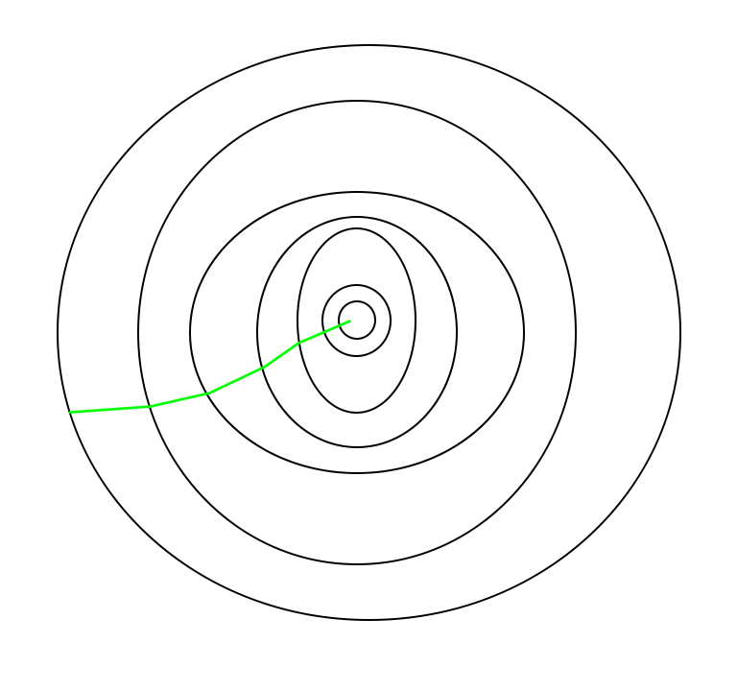
Batch Gradient Descent:

Slide 6
Stochastic Gradient Descent (SGD):
The word ‘stochastic‘ means a system or a process that is linked with a random probability.
Hence, in Stochastic Gradient Descent, a few samples are selected randomly instead of the whole data set for each iteration.
In Gradient Descent, there is a term called “batch” which denotes the total number of samples from a dataset that is used for calculating the gradient for each iteration.
In typical Gradient Descent optimization, like Batch Gradient Descent, the batch is taken to be the whole dataset. Although, using the whole dataset is really useful for getting to the minima in a less noisy and less random manner, but the problem arises when our datasets get big.

Slide 7
Suppose, you have a million samples in your dataset, so if you use a typical Gradient Descent optimization technique, you will have to use all of the one million samples for completing one iteration while performing the Gradient Descent, and it has to be done for every iteration until the minima are reached. Hence, it becomes computationally very expensive to perform.
This problem is solved by Stochastic Gradient Descent. In SGD, it uses only a single sample, i.e., a batch size of one, to perform each iteration. The sample is randomly shuffled and selected for performing the iteration.

Slide 8
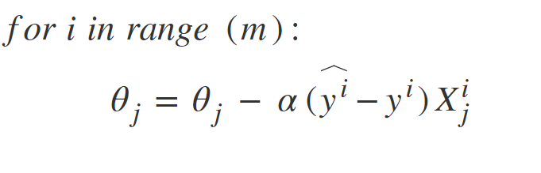
SGD algorithm:

Slide 9
SGD algorithm:
So, in SGD, we find out the gradient of the cost function of a single example at each iteration instead of the sum of the gradient of the cost function of all the examples.
In SGD, since only one sample from the dataset is chosen at random for each iteration, the path taken by the algorithm to reach the minima is usually noisier than your typical Gradient Descent algorithm.
But that doesn’t matter all that much because the path taken by the algorithm does not matter, as long as we reach the minima and with a significantly shorter training time.

Slide 10
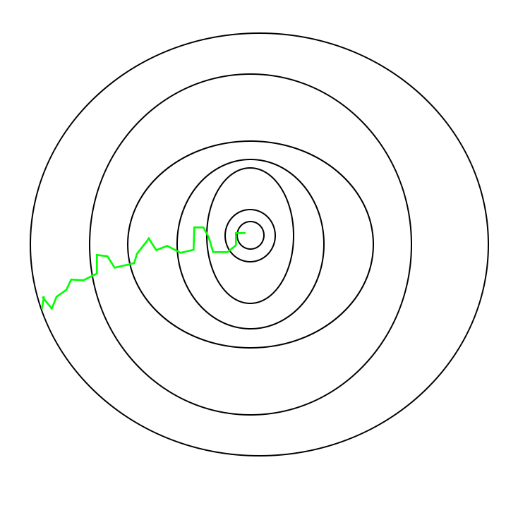
SGD algorithm:

Slide 11
Mini Batch Gradient Descent
We have seen the Batch Gradient Descent. We have also seen the Stochastic Gradient Descent. Batch Gradient Descent can be used for smoother curves.
SGD can be used when the dataset is large. Batch Gradient Descent converges directly to minima. SGD converges faster for larger datasets. But, since in SGD we use only one example at a time, we cannot implement the vectorized implementation on it.
This can slow down the computations. To tackle this problem, a mixture of Batch Gradient Descent and SGD is used.
Neither we use all the dataset all at once nor we use the single example at a time. We use a batch of a fixed number of training examples which is less than the actual dataset and call it a mini-batch.
Doing this helps us achieve the advantages of both the former variants we saw. So, after creating the mini-batches of fixed size, we do the following steps in one epoch:

Slide 12
Mini Batch Gradient Descent
Pick a mini-batch
Feed it to Neural Network
Calculate the mean gradient of the mini-batch
Use the mean gradient we calculated in step 3 to update the weights
Repeat steps 1–4 for the mini-batches we created

Slide 13
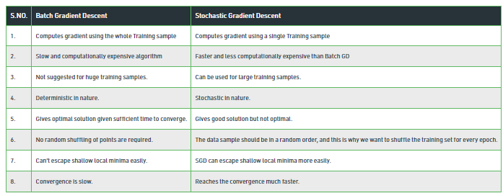
Difference between Batch Gradient Descent and Stochastic Gradient Descent

